Slide 1
Stochastic Yan Network in Fly Eye Development
Herman Gudjonson
04/23/15

Slide 2
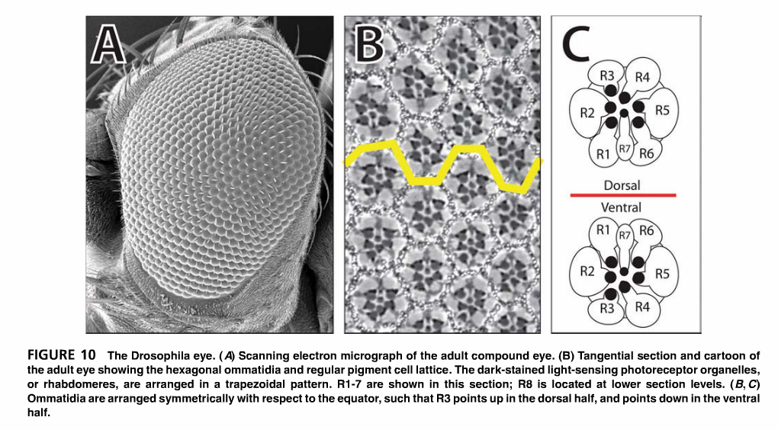
Drosophila eye is composed of a regular array of ommatidium
Doroquez and Rebay, 2006.

Slide 3
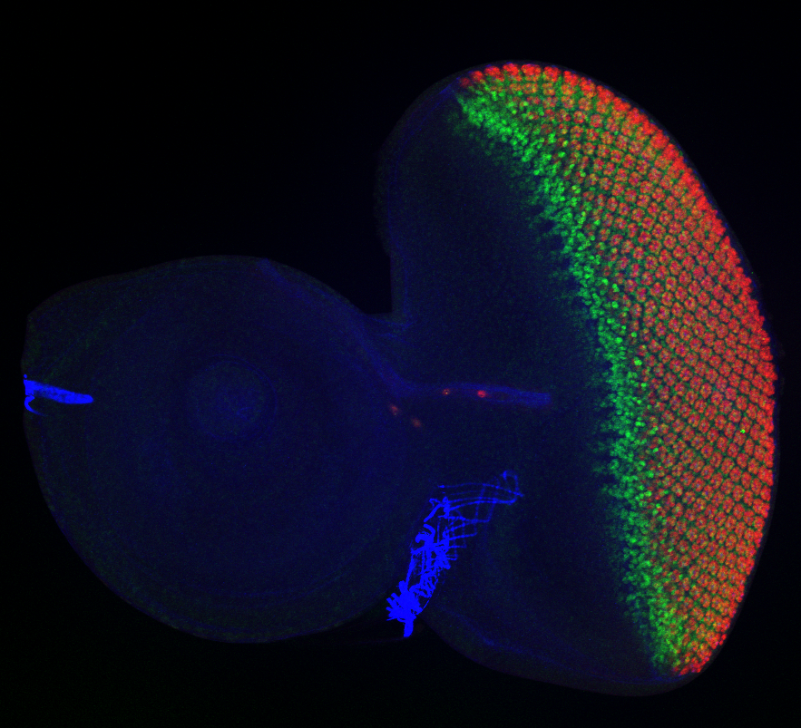
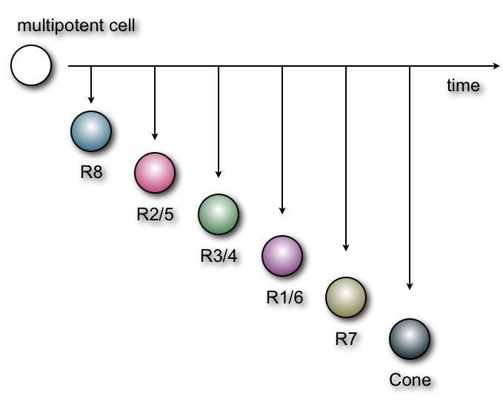
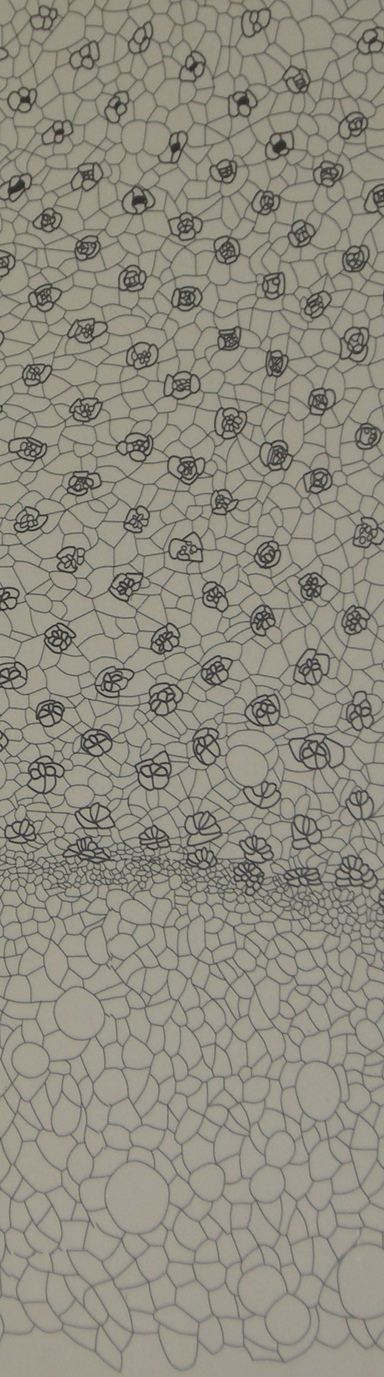
Cell fate specification is robust:
Developmental decisions are made in reproducible ways
hundreds of times during retina patterning
Eye disc
Antennal disc
Anterior
Posterior
anti-YAN antibody
anti-ELAV antibody
Drawing by T. Wolf
Morphogenetic Furrow
developmental gradient

Slide 4
Cell fate specification is robust:
Developmental decisions are made in reproducible ways
hundreds of times during retina patterning
Eye disc
Antennal disc
Anterior
Posterior
anti-YAN antibody
anti-ELAV antibody
Furrow
movement
Drawing by T. Wolf
Morphogenetic Furrow
developmental gradient

Slide 5
Cell fate specification is robust:
Developmental decisions are made in reproducible ways
hundreds of times during retina patterning
Eye disc
Antennal disc
Anterior
Posterior
anti-YAN antibody
anti-ELAV antibody
Furrow
movement
Cell Differentiation
Drawing by T. Wolf
Morphogenetic Furrow
developmental gradient

Slide 6
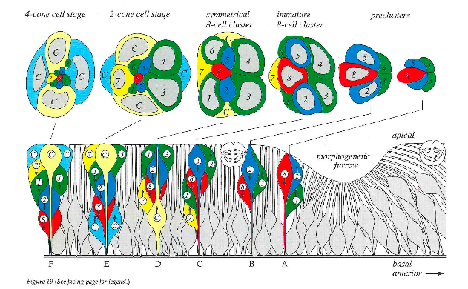
Nuclei position moves in the Z-plane during
eye cell differentiation
4 cone cell stage 2 cone cell stage symmetrical 8-cell cluster immature 8 cell cluster preclusters
Apical
Apical
Morphogenetic
Furrow
Morphogenetic
furrow
From Wolf & Ready, Cold Spring Harbor (1993)
Developmental gradient
Basal Anterior
Basal Posterior

Slide 7
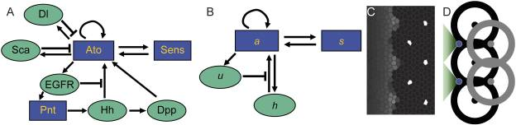
‘Switch and Template’ patterning mechanism
Diffusive species indicated by ellipses
Short range inhibitor u and long range, slowly varying activator h together lead to propagating wave of patterned R8’s with high Ato and Sen
Proc Natl Acad Sci U S A. 2011 July 5; 108(27): 11145–11150.

Slide 8
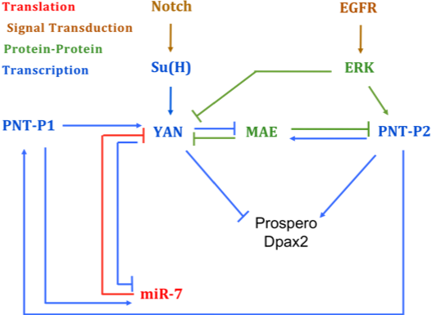
Differentiation of neurons is regulated by Notch and EGFR signaling

Slide 9
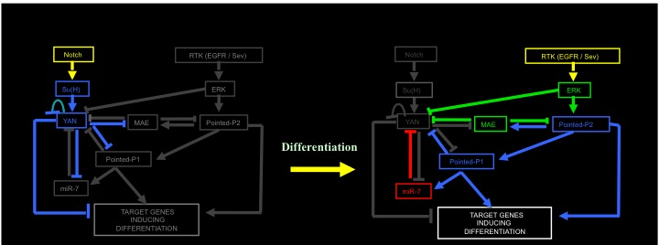
Antagonistic signaling control differentiation decision
Multipotent Precursor State
Differentiating Cell State
Image reproduced from Pulsing and ratio modulation of the ETS transcription factors Yan and Pointed regulate the transit to differentiation poster by Nicolás Peláez et al. 2014

Slide 10
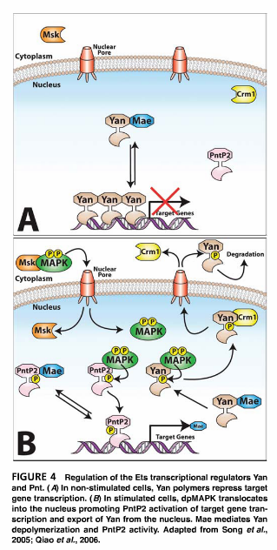
Mechanisms of Yan regulation
Multipotent Precursor State
Differentiating Cell State
Two mechanisms of Yan inhibition – protein level (via Mae) and transcript level (via miR-7)
Mae and miR-7 are similarly regulated by Yan
miR-7 is also inhibiting Yan production by sequestering/degrading Yan mRNA
Doroquez and Rebay, 2006.

Slide 11
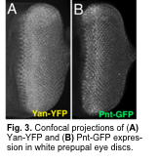
Experimental Yan Dynamics

Slide 12
Experimental Yan dynamics in differentiating cells

Slide 13
Yan dynamics in EGFR mutant backgrounds
EGFR ts – temperature sensitive EGFR, at non-permissive temperature EGFR signaling reduced
Ras-v12 – constitutively active EGFR signaling
Yan affected by EGFR modulation differently in multipotent cells vs differentiating cells

Slide 14
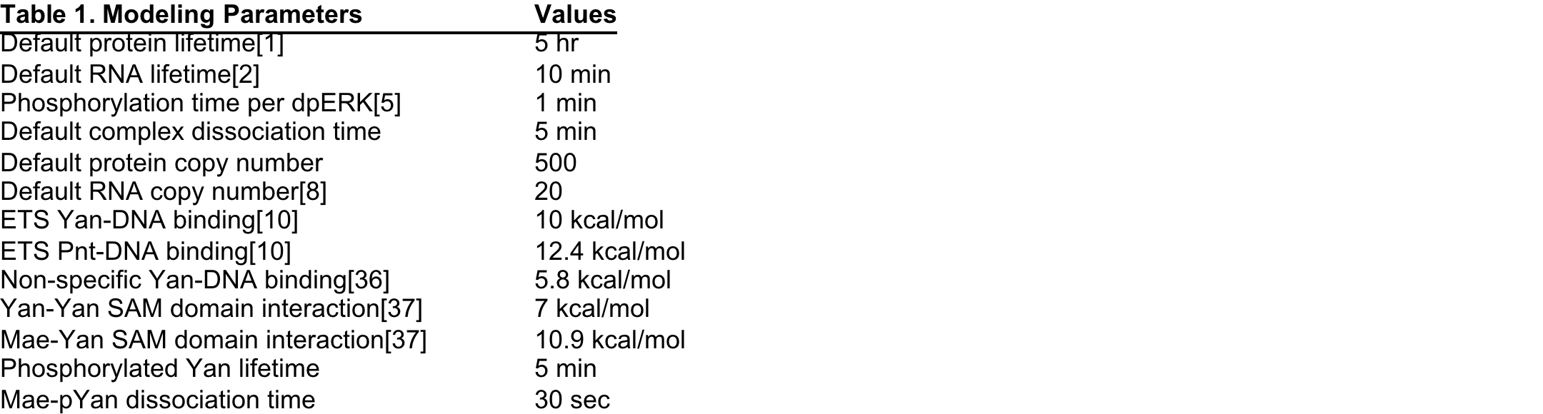
Stochastic model of Yan network in an individual cell
Gillespie simulations of protein interactions, phosphorylation, approximate promoter binding. Signaling inputs Su(H) and dpERK controlled by time-dependent functions.

Slide 15
Mae/miR7 promoter site model
dGets = 10 kcal (56nM)
dGns = 5.8 kcal (50uM)
dGsam = 7 kcal (7uM)
dGpnt = 12.4 kcal (1nM)
Following Matt Hope’s thermodynamic multi-site model for Yan binding
Z = 1 +
+ [Y] exp(dGets/KbT) + [Y] exp(dGns/KbT)
+ [Y]² exp((dGets + dGns + dGsam)/KbT) + [Y-Y] exp((dGets + dGns)/KbT)
+ [P1] exp(dGpnt/KbT) + [P2p] exp(dGpnt/KbT)
dimer Yan - repressive
Y
Y
unbound
dGets + dGns (+ dGsam)
NS
ETS
NS
ETS
Y
dGets
P1
dGpnt
NS
ETS
NS
ETS
single Yan
Pnt bound - activating
Y
P2p
dGns
dGpnt
NS
ETS
NS
ETS

Slide 16
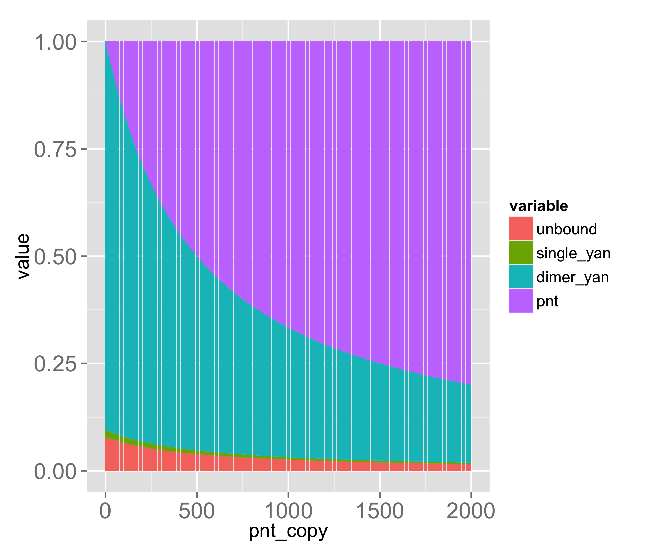
Mae/miR-7 promoter occupancy
YTotal = 500
dGP = 12.4 kcal (1nM)
At ~150 copies of Yan, dimer bound fraction equals unbound fraction
Binding energies determine appropriate copy number ranges
Yan promoter model similar, but with stronger Pnt binding!

Slide 17
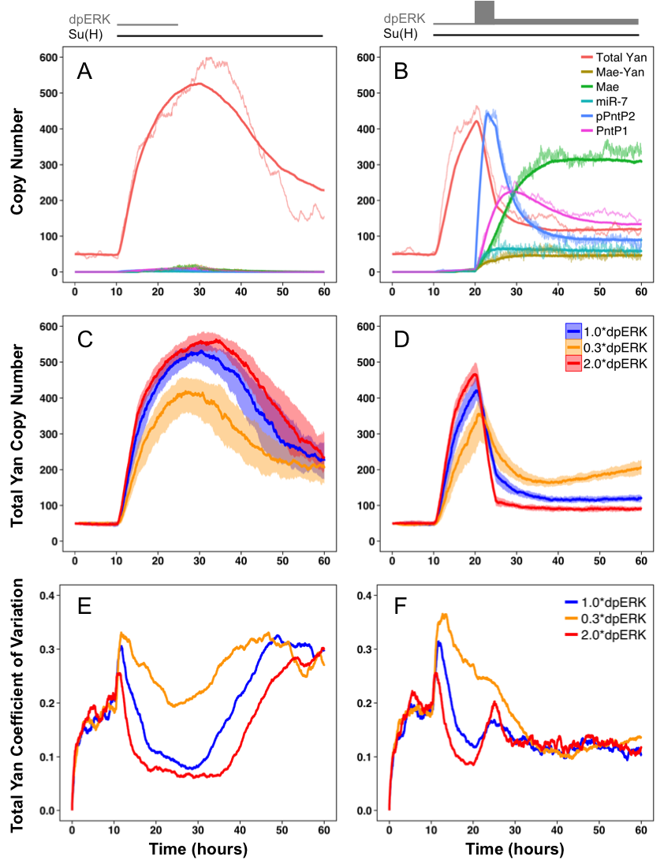
Simulated Yan network dynamics
Multipotent Precursor
Differentiating Cell

Slide 18
Simulated EGFR modulation
Multipotent Precursor
Differentiating Cell

Slide 19
Experimental Yan Noise

Slide 20
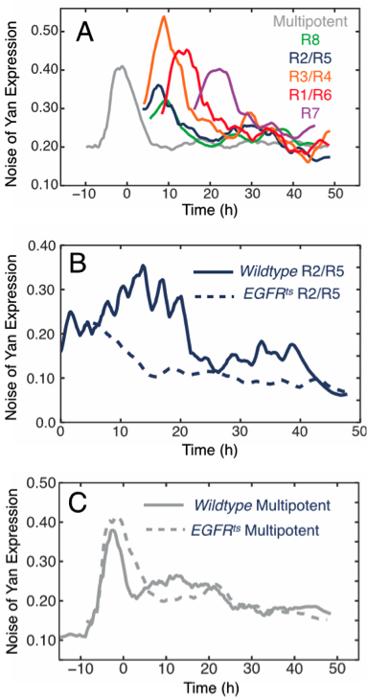
Yan Noise in EGFR mutant background
Multipotent Precursor
Differentiating Cell
Fig. 5. (A) Yan-YFP expression noise (coefficient of variation) spikes accompany both the onset of expression in multipotent cells and the transition toward differentiation. (B,C) Effects of EGFR^{ts} in differentiating versus multipotent cells.

